Slide 1
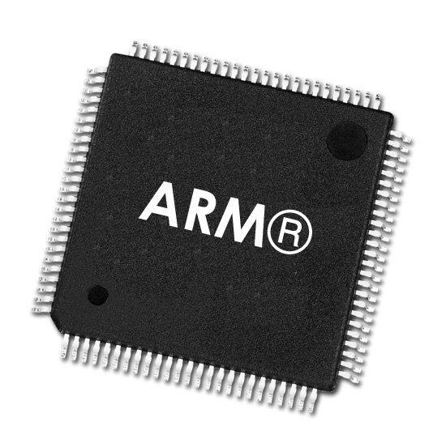
ARM Pipeline
Alireza Bolourian
CPE 300L

Slide 2

Goal
Build a five-stage pipeline for a subset of the ARMv4 instruction set architecture that supports the standard instructions:
ADD
SUB
ORR
AND
LDR
STR
B

Slide 3
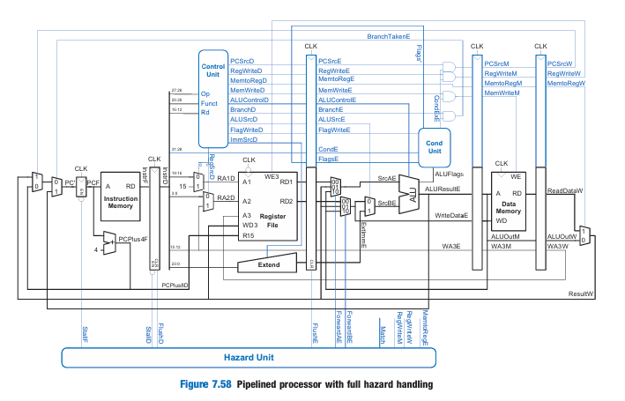
Pipeline Diagram
Registers added to divide the processor into 5 stages
Control signals are carried to the next stage by the registers
Hazards need to be addressed
Data Hazards
Control Hazards
Digital Design and Computer Architecture ARM Edition by Sarah & David Harris

Slide 4
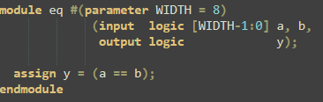
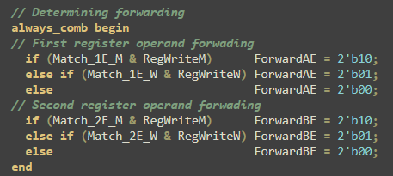
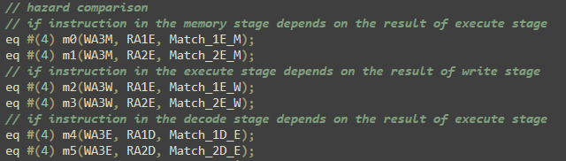
RAW Hazard
Hazard created when one instruction writes into a register, and the next instruction reads this register
Solved by forwarding
Adding multiplexers to the execute stage
Select operand from Register file, Memory or Writeback stage
No need to forward from Writeback stage to the Decode stage because it is possible to write and read in the same cycle

Slide 5
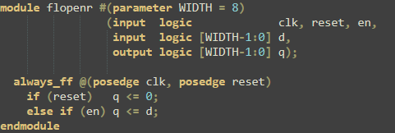


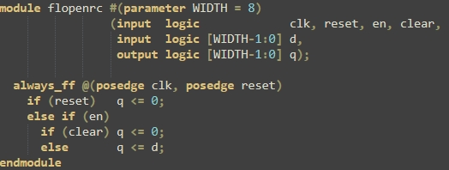
LDR Hazard
LDR does not finish reading until the end of memory stage
It cannot be forward from memory stage
Stall the Fetch and Decode stages
Flush the Execute stage

Slide 6
Control Hazard
Branch decision cannot be made before the next instruction is fetched
Branch prediction
Branch decision made in execute stage
Branch multiplexer before the PC register
Flush Decode and Execute stages

Slide 7
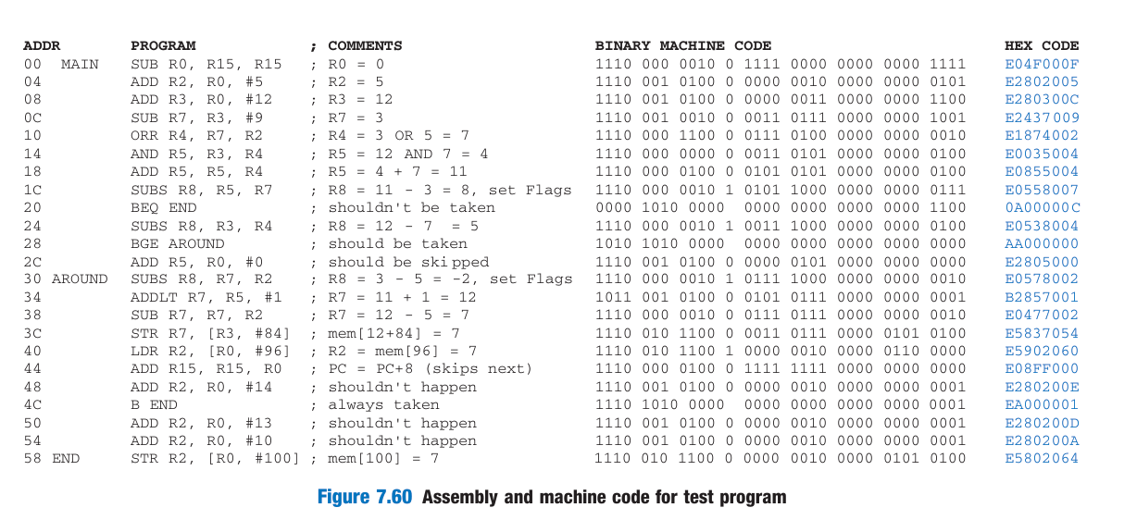
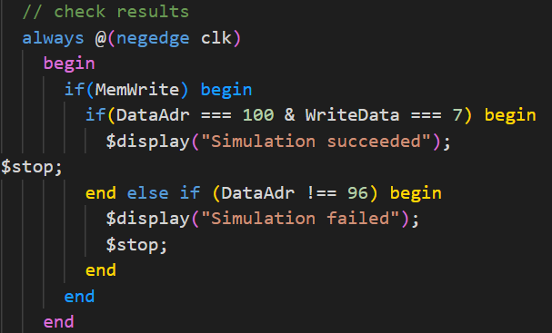
Simulation Results

Slide 8
Future Steps
More advanced optimization techniques to reduce the overhead associated with pipelining
Branch detection in the decode stage
Adding support for parallelism
Implementation on FPGA
Time analysis

Slide 9
Conclusions
Insight into pipelining and tradeoffs
Hardware simulation and debugging using systemVerilog
Attention to detail and iterative testing

Slide 10
Questions
Thank You!

Slide 11
References
Harris, S., & Harris, D. (2015). Digital Design and Computer Architecture. Morgan Kaufmann

